Slide 1
Git 101
Or: Git for Gits
David Muckle

Slide 2
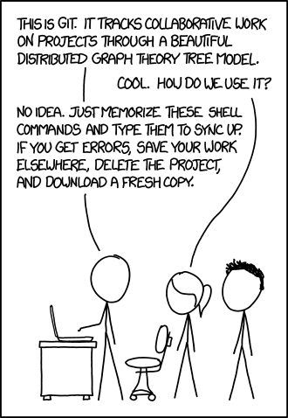
What is Git?
VCS (Version Control Software)
CVS, Mercurial, Git
Keep track of changes
Revert back to old changes
Keep multiple versions of a project
Merge versions
Synchronize projects between machines
Keep your project “in the cloud”

Slide 3
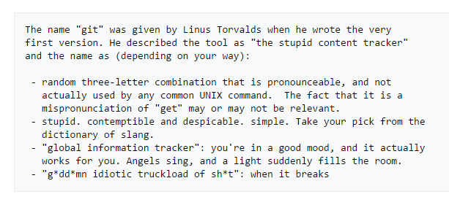


History of Git
Use in Linux development
Replacing BitKeeper
Use online
GitHub, BitBucket
Notes:
Quick slide, highlight how Git came to be and its origins.
3

Slide 4
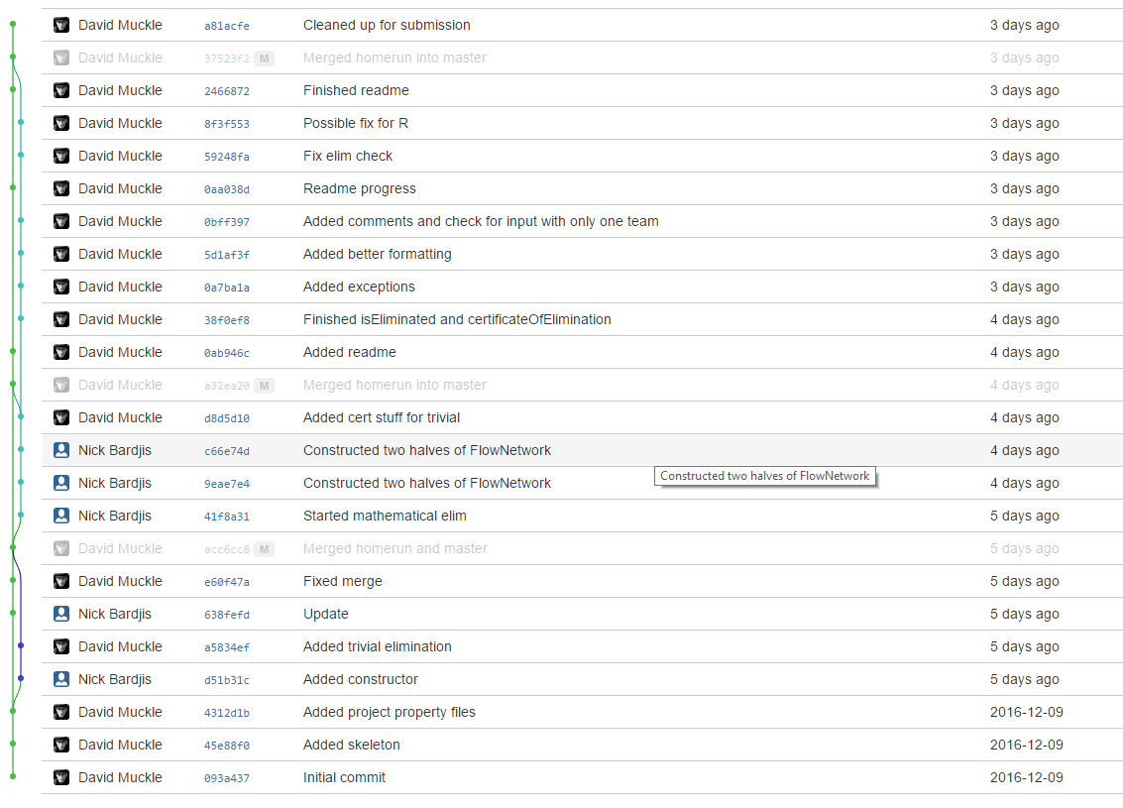
The Git Basics
git init
git clone http://example.com/repo
Use http or ssh
git add somefile.thing
git status
git commit -m ‘Comment’
git push
git pull
git branch branchname
git checkout branchname
git merge
Notes:
Break here to go through a live demonstration of each of these commands.
4

Slide 5
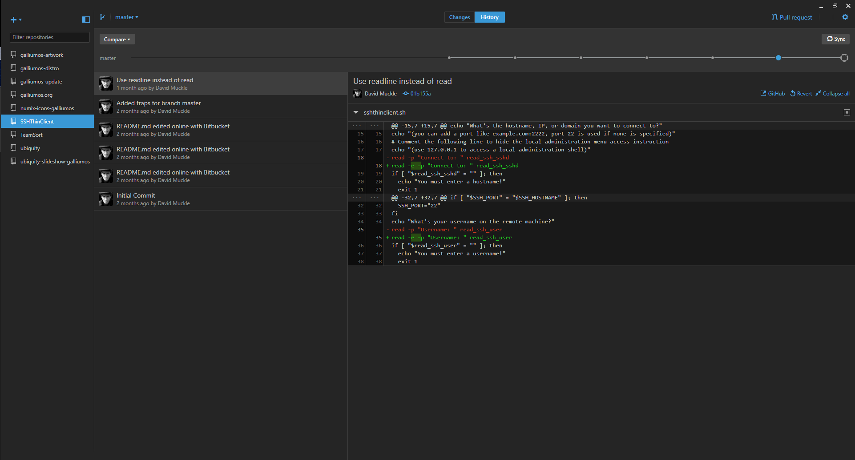
Graphical Clients
Integration with IDEs
Eclipse, Netbeans, IntelliJ
Standalone Clients
GitHub Client, Atlassian SourceTree, Git GUI
Notes:
Stress that learning how to use Git on a command line is a must before using graphical clients, as if something screws up on the client one can fall back to the command line.
5

Slide 6
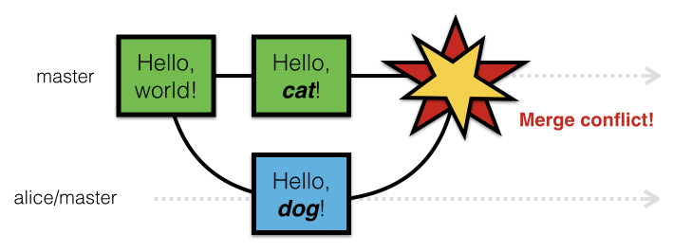
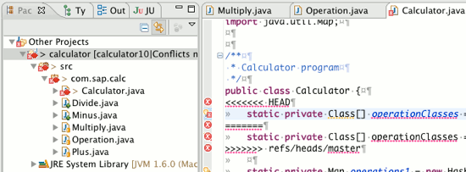
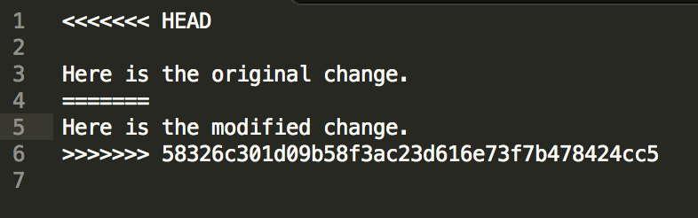
What to do if Git breaks
Notes:
A situation that many people might run into, hence a few slides on it.
6

Slide 7

Notes:
Self explanatory.
7

Slide 8
Resolving Merge Conflicts
Stay calm
Read the marked changes
Talk with your partner(s)
Figure out what to keep
Edit accordingly
Push changes
Notes:
Live demonstration of resolving a merge conflict here. Also highlight that if worse comes to worse, making a backup of code and nuking the local repo is fine too.
8

Slide 9
Using with your Clark CS Account
Create a repository on system
Commit changes
On local computer, git clone ssh://username@csgateway.clarku.edu/home/username/pathtorepo
Won’t work with pair programming
Notes:
Because people really don’t use this resource enough!
9

Slide 10
Suggested Setup for Pair Programming
Use BitBucket
Create repository with private access
Add members to repository
OR
Create team with partner
Create repository under team
Notes:
Basically what this whole presentation is for. Make note that this is only one of many ways to do this.
10

Slide 11
Can I use Git for other things?
Absolutely!
Essays
Cover letters
Image editing
Recipes
Program settings (dotfiles)
This PowerPoint
Notes:
Because Git is really cool and can be used for a whole bunch of things.
11

Slide 12
Other Git Resources
Oh Shit, git! http://ohshitgit.com
Gitless http://gitless.com/
Github
Notes:
12

Slide 13
Go forth and Commit!

